Slide 1

APBD – lecture 4
SQL Connection / SQL Command
Dependency injection in REST
API Validation in REST API

Slide 2
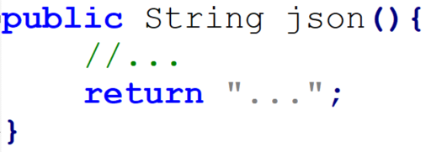
Notes 1 - names
Using correct and meaningful names

Slide 3
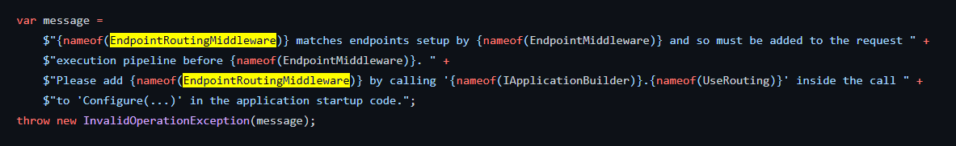
Notes 1 - names

Slide 4
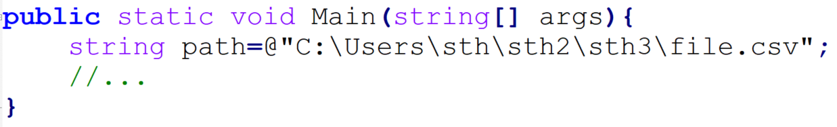
Notes 2 – hardcoding paths

Slide 5
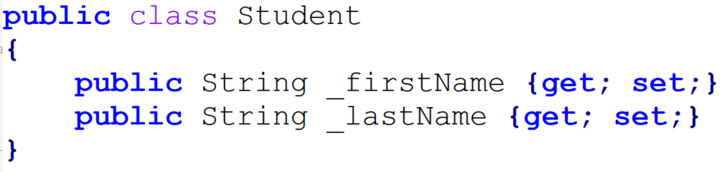
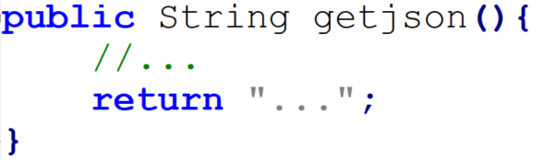
Notes 3 - conventions

Slide 6
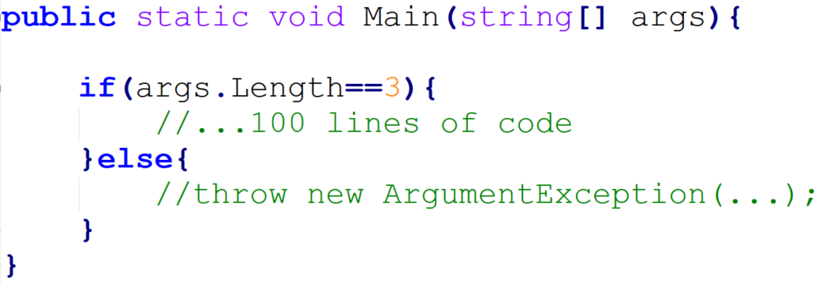
Notes 4 – fail-fast, invert ifs

Slide 7
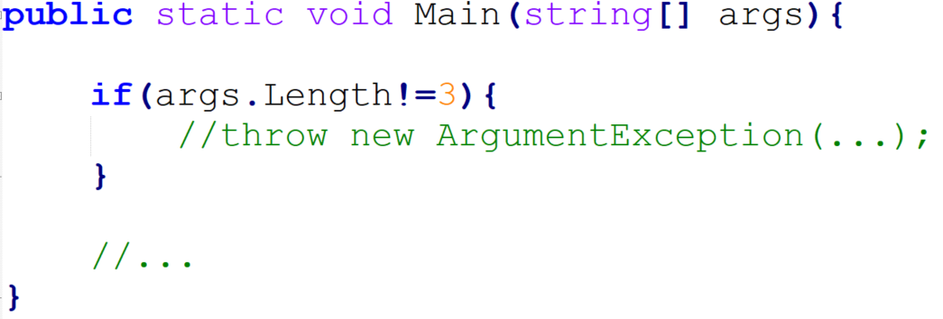
Notes 4 – fail-fast, invert ifs

Slide 8
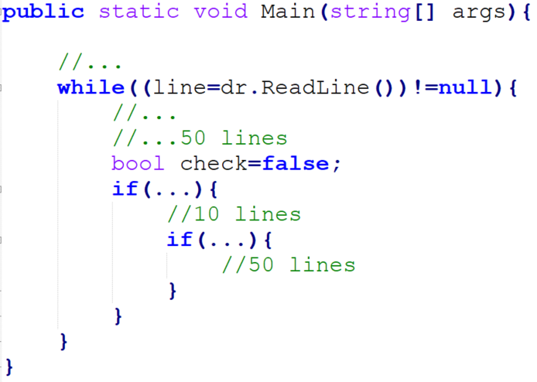
Notes 5 – looong methods

Slide 9
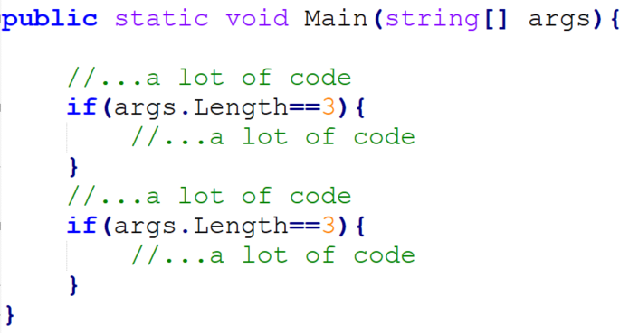
Notes 5 – magic strings/magic numbers

Slide 10
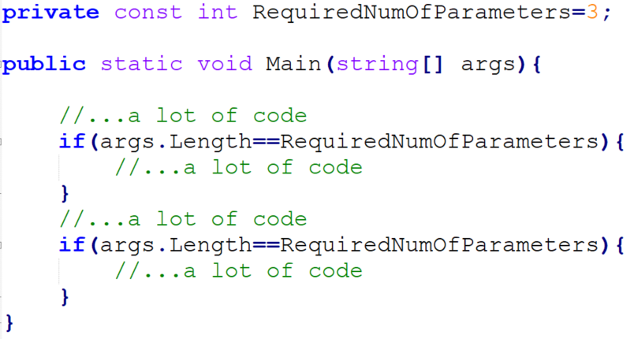
Notes 5 – magic strings/magic numbers

Slide 11
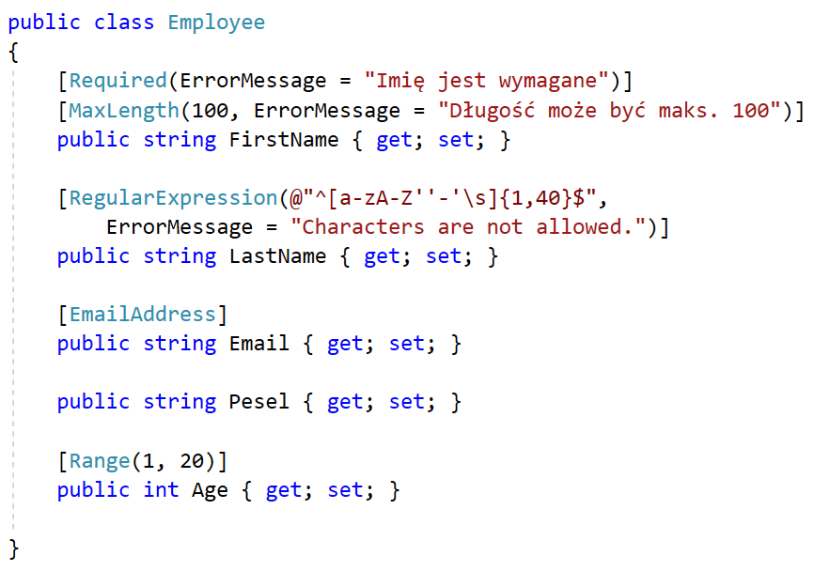
Declarative validation

Slide 12
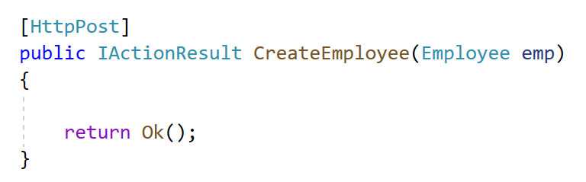
Declarative validation

Slide 13
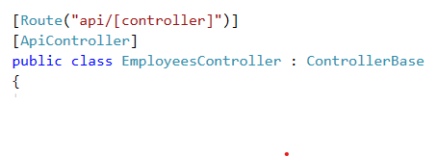
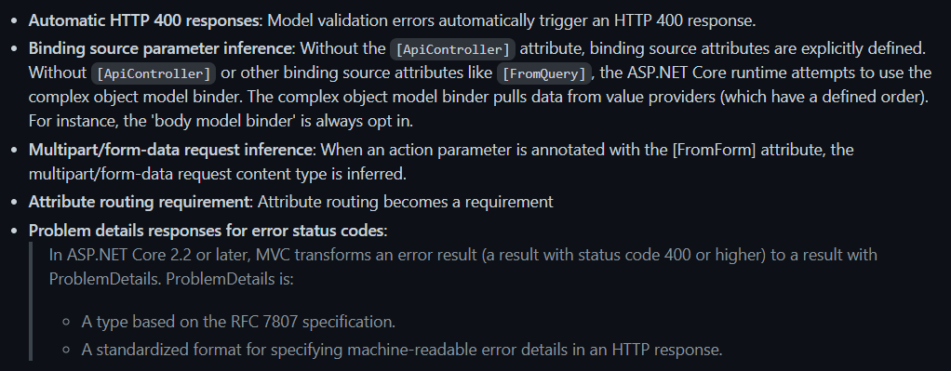
Declarative validation

Slide 14
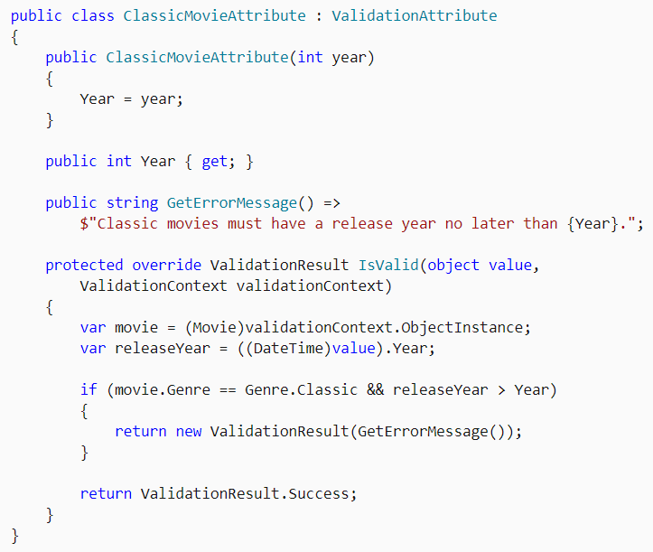
Custom validation attribute

Slide 15
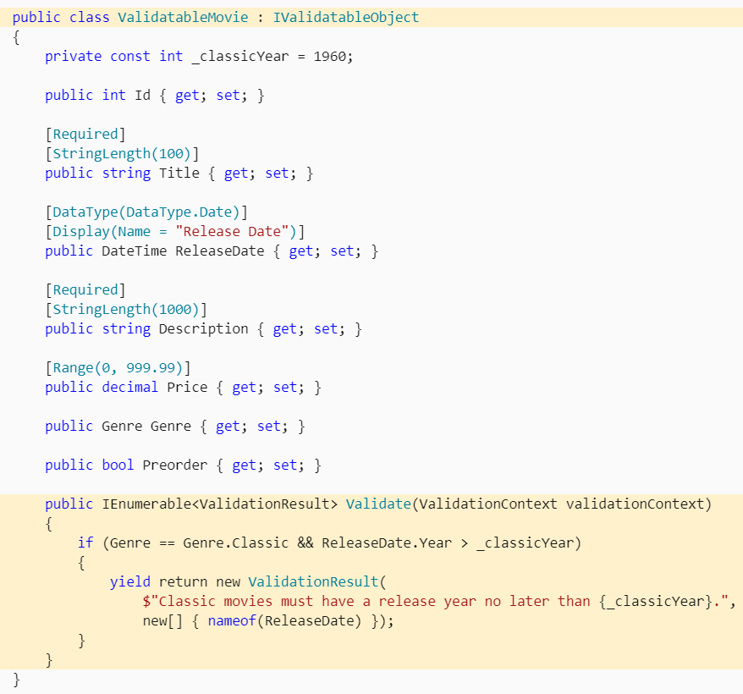
IValidatableObject

Slide 16
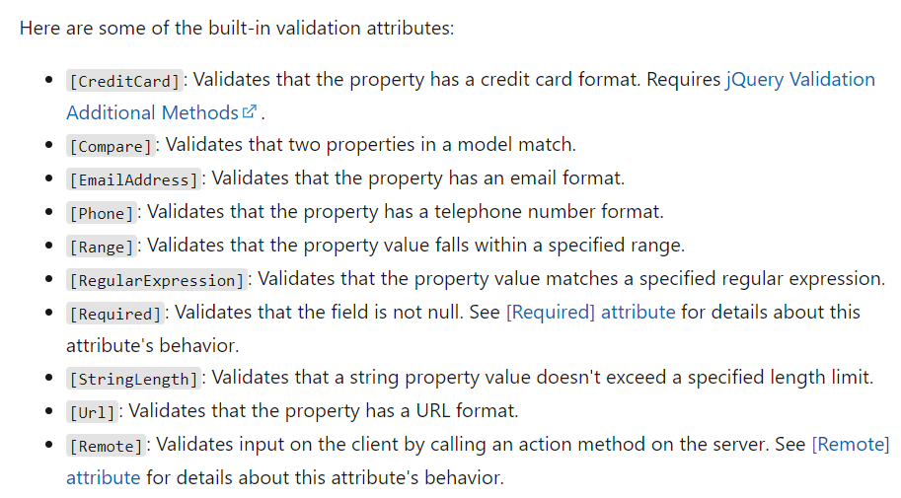
Data annotations

Slide 17
Dependency injection
Dependency Injection (DI) is a software design pattern that allows us to develop loosely coupled code.
.NET supports the dependency injection (DI) software design pattern, which is a technique for achieving Inversion of Control (IoC) between classes and their dependencies

Slide 18
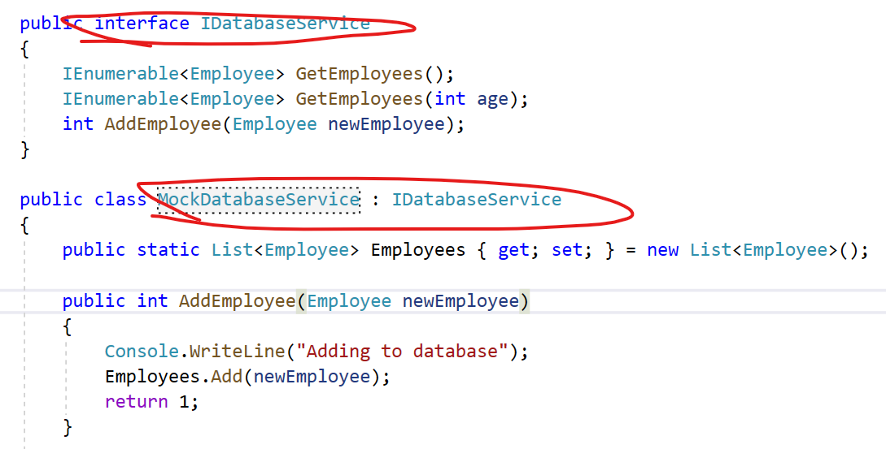
Preparing the dependency

Slide 19
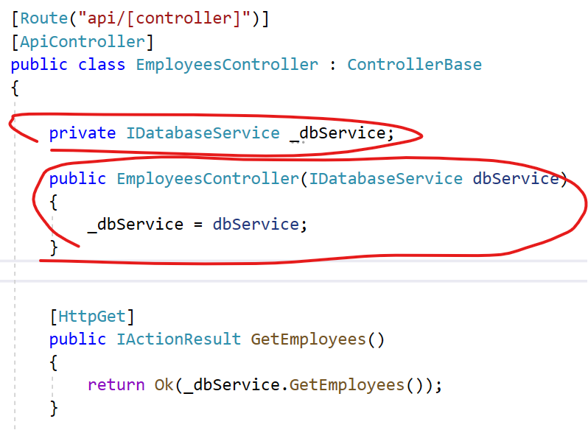
Injection of dependency through constructor

Slide 20
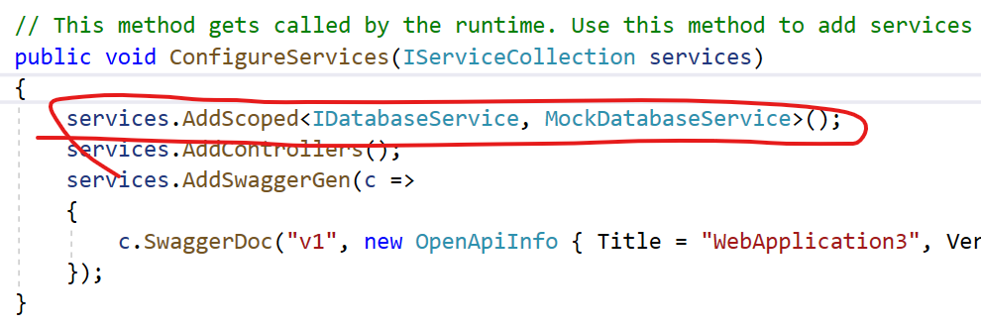
Registering the dependency

Slide 21
Types of injection
Constructor Injection: In the constructor injection, the injector supplies the service (dependency) through the client class constructor.
Property Injection: In the property injection (aka the Setter Injection), the injector supplies the dependency through a public property of the client class.
Method Injection: In this type of injection, the client class implements an interface which declares the method(s) to supply the dependency and the injector uses this interface to supply the dependency to the client class.

Slide 22
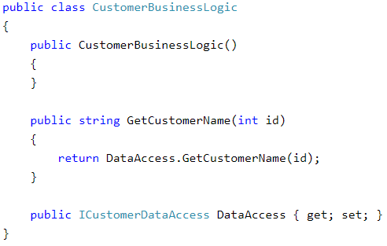
Property injection

Slide 23
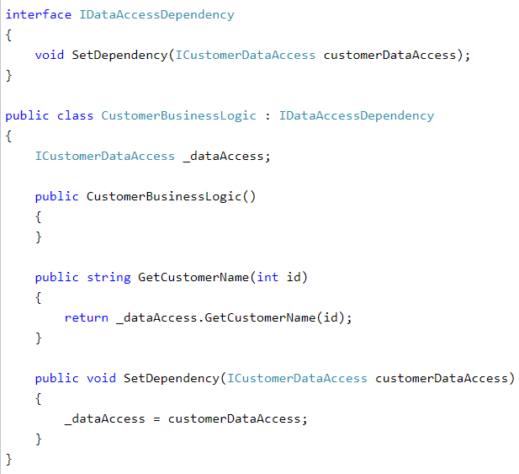
Method injection

Slide 24
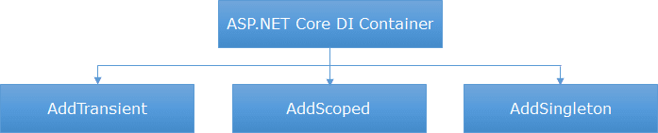
Different methods for registering service in dependency injection container

Slide 25
Different methods for registering service in dependency injection container
AddSingleton() - A Singleton service is created only one time per application and that single instance is used throughout the application lifetime. As the name suggest, AddSingleton() method creates a Singleton service. A Singleton service is created when it is first requested. This same instance is then used by all the subsequent requests.

Slide 26
Different methods for registering service in dependency injection container
AddTransient() - This method creates a Transient service. A new instance of a Transient service is created each time it is requested.
AddScoped() - This method creates a Scoped service. A new instance of a Scoped service is created once per request within the scope. For example, in a web application it creates 1 instance per each http request but uses the same instance in the other calls within that same web request.

Slide 27
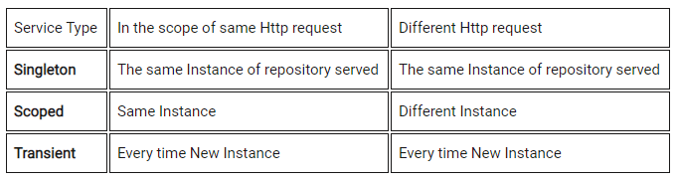
Different methods for registering service in dependency injection container

Slide 28
Working with relational databases
Connection – To work with the data in a database, the first obvious step is the connection. The connection to a database normally consists of the below-mentioned parameters.
Database name / Data source
Credentials
Optional parameters
Selecting data from the database – Once the connection has been established, the next important aspect is to fetch the data from the database.

Slide 29
Working with relational databases
Inserting data into the database
Updating data into the database
Deleting data from a database

Slide 30
Different way to interact with database
Low level interaction – using database providers and sending the requests in SQL language
Different issues:
Different relational databases have different communication protocols
Managing the connection
Parsing the results into objects
Managing the changes in database structure

Slide 31
Database providers
There are database specific providers (they can usually communicate with a specific type of database – MS SQL Server, Oracle, MySQL, PostgreSQL, etc.)
SqlConnection/SqlCommand
There are more generic providers which acts as a middle layer which allows us to communicate with different relational systems
For ex. OdbcConnection/OdbcCommand
Usually they may be slower than database specific providers

Slide 32
Working with relational databases
SqlConnection/SqlCommand comes from namespace System.Data.SqlClient;
They represent extension of generic DbConnection class
https://github.com/microsoft/referencesource/blob/master/System.Data/System/Data/SqlClient/SqlConnection.cs
https://github.com/microsoft/referencesource/blob/master/System.Data/System/Data/SqlClient/SqlCommand.cs

Slide 33
SqlConnection
The SqlConnection class handles MS SQL Server database connections.
It initiates a connection to your SQL database. This class is best used in a using resource acquisition statement.
We call Open to query the database with SqlCommand.

Slide 34
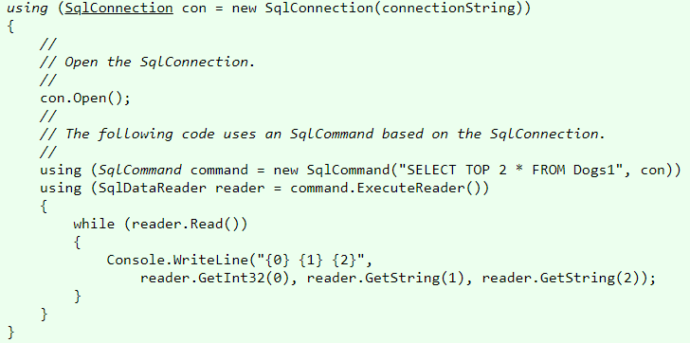
SqlConnection

Slide 35
SqlConnection
When creating a new instance we should provide the ConnectionString.
ConnectionString usually defines:
Data source
Database name
User credentials
Optional parameters (for ex. timeout)

Slide 36
SqlConnection

Slide 37
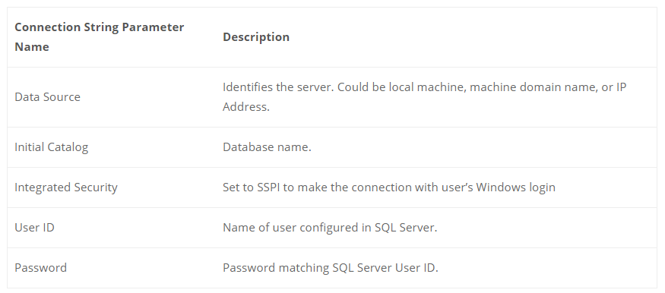
SqlConnection

Slide 38
SqlConnection
The responsibility of SqlConnection is opening, managing and closing the connection.
SqlConnection is not „interested” what we are sending to the database. This is another responsibility
Remember that SqlConnection represents an important resource and we should always close it (dispose it).

Slide 39
SqlConnection
When you are done using the connection object, you must close it. Failure to do so could have serious consequences in the performance and scalability of your application.

Slide 40
What is connection pooling?
Connection pooling is a strategy that is used to minimize the cost associated with opening and closing connections to the database.
It enables you to reuse connections rather than create new connections to the database as and when they are requested.
A connection pool contains a collection of idle, open, reusable connections. The pooler manages the connection pool and maintains a set of active connections for each given connection metadata, connection configuration information.

Slide 41
What is connection pooling?
Note that you can have multiple connection pools exist in the same application domain.
A connection pool is created per unique connection string that you use to connect to the database and not per database.
First time you connect to a database with a particular connection string, a new connection pool is created
When you connect to the same database with the same connection string the next time, no new connection pool is created, rather, the existing connection pool is reused.

Slide 42
What is connection pooling?
We can control the connection pool with certain optional attributes in connection string
ConnectionTimeout -- this is used to specify the wait period (in seconds) when a new database connection is requested for. The default value is 15.
MinPoolSize -- this represents the minimum number of connections in the pool.
MaxPoolSize -- this represents the maximum number of connections in the pool. The default value is 100.
Pooling -- this controls if connection pooling is turned on or off and can have a value of true of false. When this is set to true, the requested connection is retrieved from the appropriate connection pool.
In order to ensure that connection pooling works efficiently, you should ensure that you close the database connections when they are no longer needed.

Slide 43
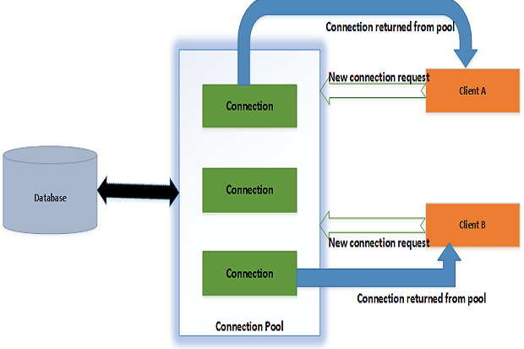
What is connection pooling?

Slide 44
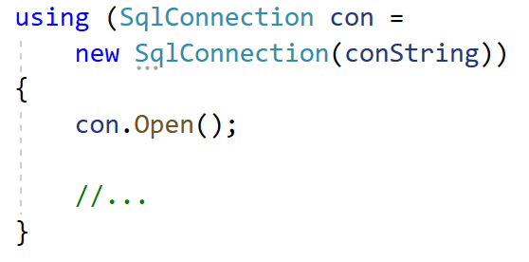
SqlConnection – simple usage example

Slide 45
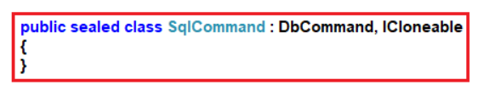
SqlCommand
SqlCommand class in C# is used to store and execute the SQL statement against the SQL Server database.

Slide 46
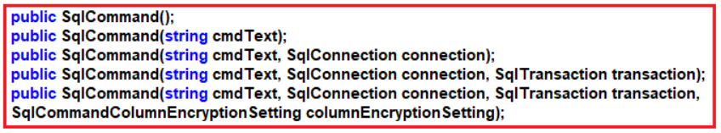
SqlCommand – creation

Slide 47
SqlCommand – creation
SqlCommand():
This constructor is used to initializes a new instance of the System.Data.SqlClient.SqlCommand class..
SqlCommand(string cmdText):
It is used to initializes a new instance of the System.Data.SqlClient.SqlCommand class with the text of the query. Here, the cmdText is the text of the query that we want to execute.

Slide 48
SqlCommand – creation
SqlCommand(string cmdText, SqlConnection connection):
It is used to initializes a new instance of the System.Data.SqlClient.SqlCommand class with the text of the query and a System.Data.SqlClient.SqlConnection. Here, the cmdText is the text of the query that we want to execute, and the parameter connection is the connection to an instance of SQL Server.

Slide 49
SqlCommand – different methods
BeginExecuteNonQuery(): This method initiates the asynchronous execution of the Transact-SQL statement or stored procedure that is described by this SqlCommand.
Cancel(): This method tries to cancel the execution of a SqlCommand.
CreateParameter(): This method creates a new instance of a SqlParameter object.
ExecuteReader(): This method Sends the SqlCommand.CommandText to the SqlCommand.Connection and builds a SqlDataReader.

Slide 50
SqlCommand – different methods
ExecuteScalar(): This method Executes the query and returns the first column of the first row in the result set returned by the query. Additional columns or rows are ignored.
ExecuteNonQuery(): This method executes a Transact-SQL statement against the connection and returns the number of rows affected.

Slide 51
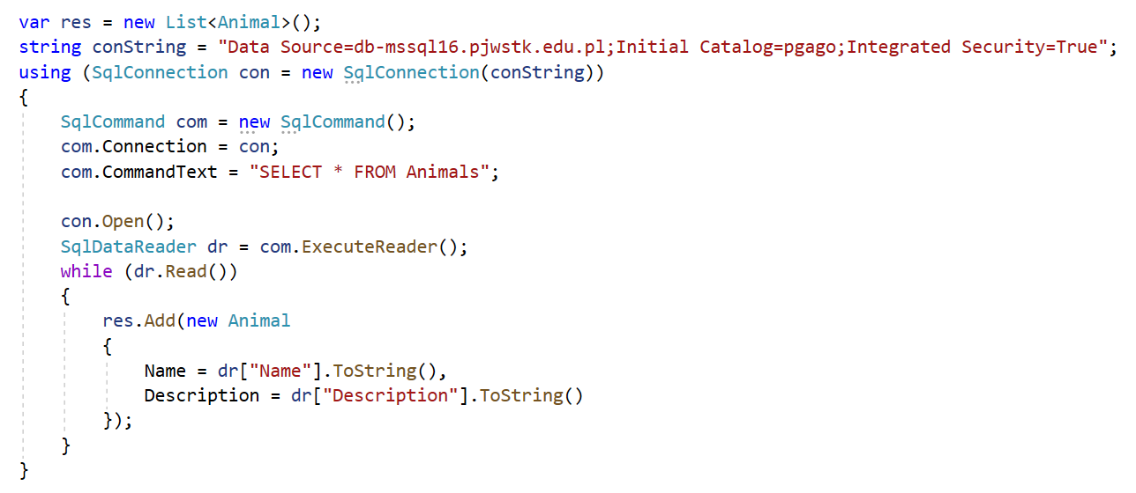
SqlConnection, SqlCommand - example

Slide 52
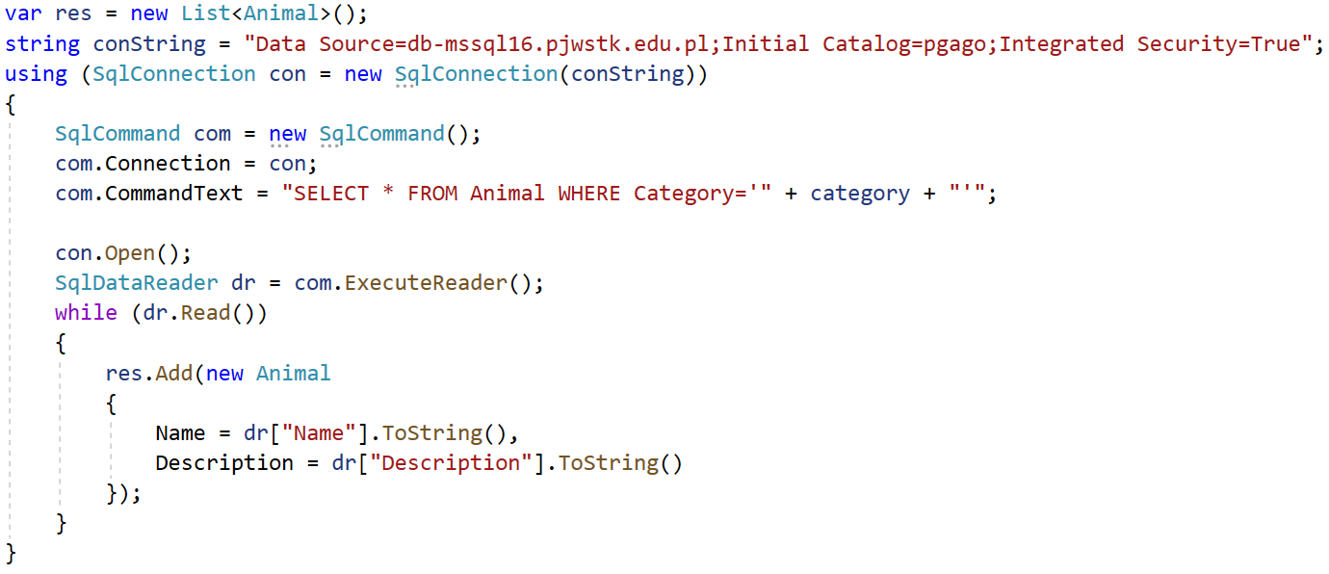
SqlCommand – passing parameters

Slide 53
SqlInjection
https://owasp.org/www-community/attacks/SQL_Injection
https://cheatsheetseries.owasp.org/cheatsheets/SQL_Injection_Prevention_Cheat_Sheet.html

Slide 54
SqlCommand – using parameters
SqlParameter -
https://docs.microsoft.com/en-us/dotnet/framework/data/adonet/configuring-parameters-and-parameter-data-types
https://www.dotnetperls.com/sqlparameter

Slide 55
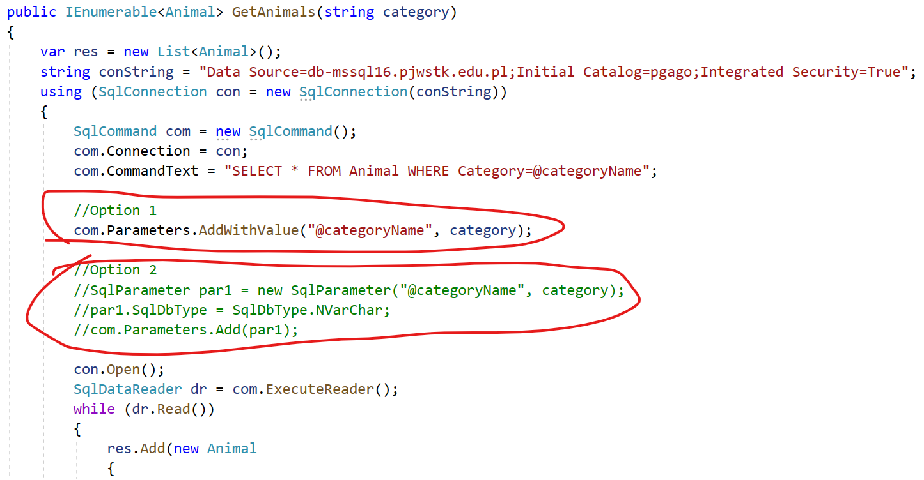
SqlCommand – using parameters

Slide 56
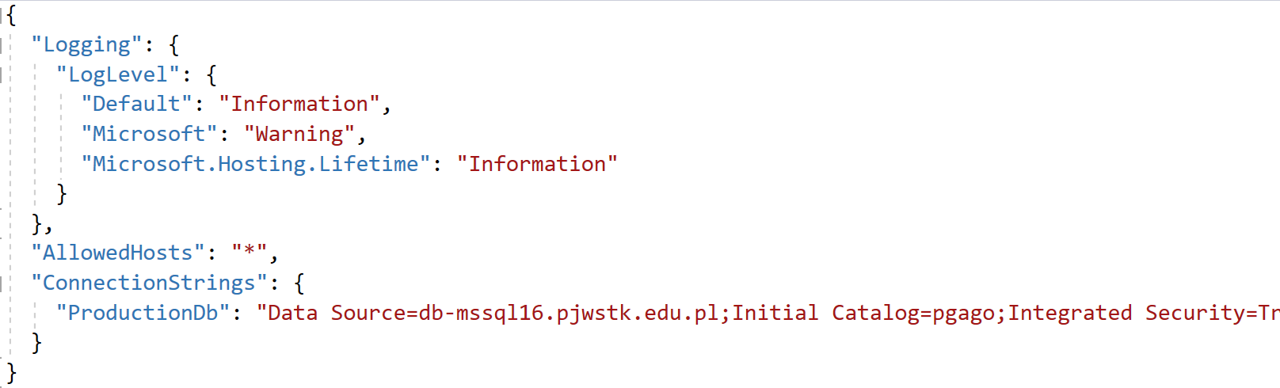
Moving the connection string to app.settings

Slide 57
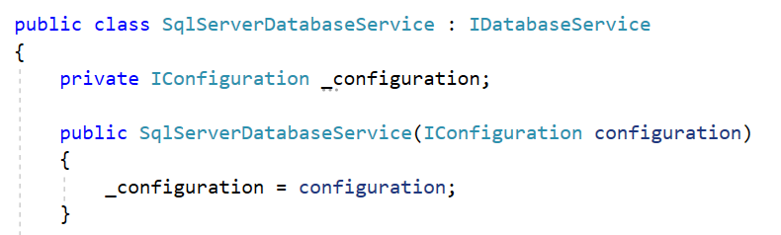
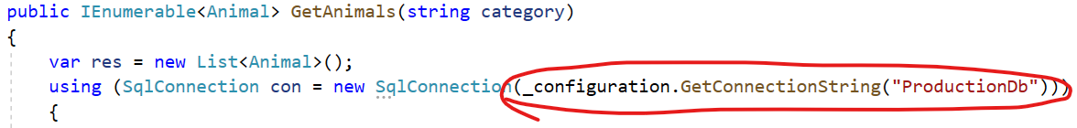
Moving the connection string to app.settings

Slide 58
Issues?
What problems may arise due to multiple concurrent connections?

Slide 59
Bibliography
https://en.wikipedia.org/wiki/Fail-fast
https://docs.microsoft.com/pl-pl/aspnet/core/mvc/models/validation?view=aspnetcore-5.0
https://docs.microsoft.com/pl-pl/aspnet/core/mvc/models/validation?view=aspnetcore-5.0#remote-attribute
https://docs.microsoft.com/en-us/aspnet/core/web-api/?view=aspnetcore-5.0
https://www.plukasiewicz.net/Artykuly/DIP_IoC_DI
https://docs.microsoft.com/pl-pl/aspnet/core/fundamentals/dependency-injection?view=aspnetcore-5.0
https://www.tutorialsteacher.com/ioc/dependency-injection
https://www.coreprogramm.com/2020/02/difference-between-addsingleton-addScoped-addTransient.html

Slide 60
Bibliography
http://www.differencebetween.net/technology/software-technology/difference-between-odbc-and-sql-2/#ixzz6D5EuzKbL
https://sekurak.pl/czym-jest-sql-injection/
https://owasp.org/www-community/attacks/SQL_Injection
https://cheatsheetseries.owasp.org/cheatsheets/SQL_Injection_Prevention_Cheat_Sheet.html
https://www.infoworld.com/article/3104045/how-does-adonet-connection-pooling-work.html
https://docs.microsoft.com/en-us/dotnet/framework/data/adonet/configuring-parameters-and-parameter-data-types
https://en.wikipedia.org/wiki/Magic_string
https://en.wikipedia.org/wiki/Magic_number_(programming)

